Slide 1


Slide 2
NEW YORK
Air BnB Guide
Like Apples
NYAirBnb’s have many varieties
Notes:
WELCOME TO THE BIG APPLE AND OUR PROJECT AN “AIR BNB GUIDE” - LIKE APPLES, NY CITIES AIRBNB’S COME IN MANY VARIETIES

Slide 3
01
02
AIR BNB’S
TYPES & PRICING
03
04
BEDROOMS & BEDS
BATHROOMS
As of 2023 there were over 20K AirBnb Listings
Studios, Lofts, Homes, Apartments, Private rooms
Single bedrooms to multi bedroom offerings
Single, Mutliple & Shared Bathrooms
Notes:
IN 2023 THERE WERE OVER 20 THOUSAND AIRBNB’S OFFERED THROUGHOUT THE CITY.
AIRBNB’S ARE AVAILABLE AS PRIVATE ROOMS IN A RESIDENCE, STUDIOS, APARTMENTS,, LOFTS AND SINGLE - FAMILY HOMES.
BEDROOMS RANGE FROM A BEDROOMS WITH A SINGLE BED TO MUTLI- BEDS IN A ROOM TO MULTIPLE BEDROOM UNITS THAT CAN HAVE 1 TO MANY BEDS

Slide 4
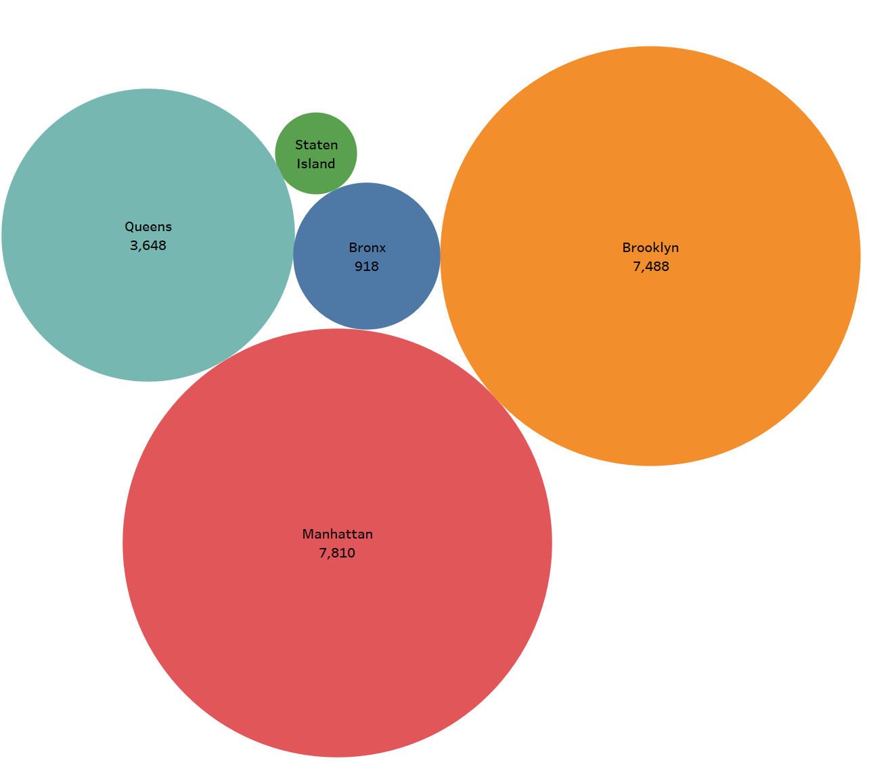
THE FIVE BOROUGHS
AirBnB listings are located throughout the five boroughs.
Mahattan -> 7810
Brooklyn -> 7488
Queens -> 3648
The Bronx -> 918
Staten Island -> 285
Notes:
NYC HAS A POPULTION OF OVER 19 MILLION PEOPLE.
DISTRIBUTED WITHIN THE FIVE BOROUGHS ,
HUNDREDS TO THOUSANDS OF AIRBNBS ARE AVAILIBLE THOUGOUT THE 5 BOROUGHS
MANHATTEN HAS THE MOST AT 7800 PLUS TO STATEN ISLAND WITH THE LEAST.

Slide 5
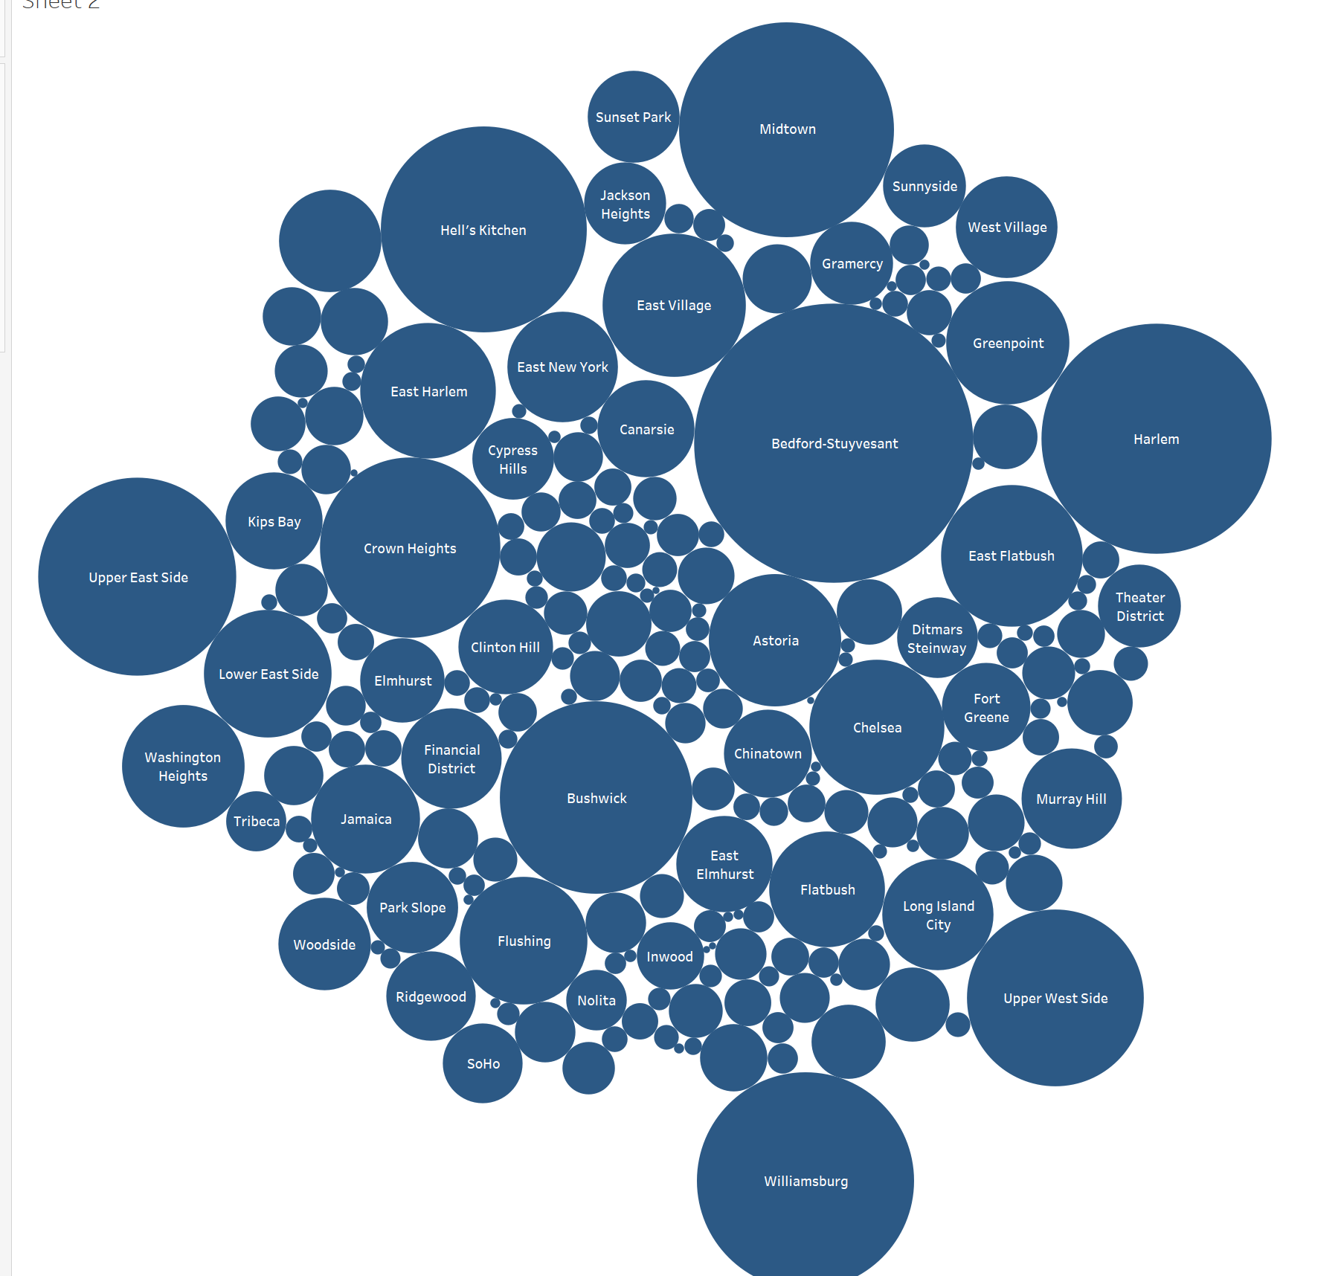
THE MANY NIEGHBORHOODS
AirBnb’s are offered throughout the 339 neighborhoods within the Five Boroughs
The most popular are:
Bedford - Stuyvesant
Harlem
Midtown
Upper East & West Side
Hell’s Kitchen
Williamsburg
Notes:
ACCORDING TO THE DEPARTMENT OF CITY PLANNING,
NYC CONTAINS 339 NEIGHBORHOODS,
RANGING IN SIZE FROM JUST A COUPLE CITY BLOCKS
TO SPRAWLING DISTRICTS WITH GREAT POPULATION COUNTS

Slide 6
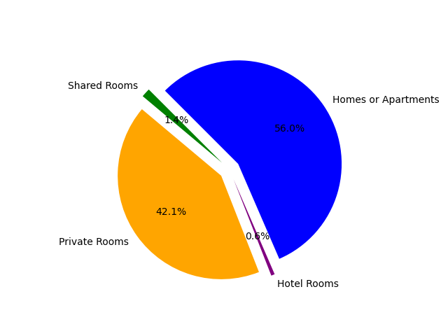
FIVE BOROUGHS AIRBnB TYPES
Homes & Apartments, Private rooms,Shared Rooms and Hotel Rooms are available.
Home/Apartments 56%
Private Rooms 42.1 %
Shared Rooms 14%
Hotel Rooms 0.6%
Notes:
AIRBNBS ARE OFFRERED IN MANY TYPES
FROM SINGLE FAMILY HOMES AND APARTMENTS
THROUGH SHARED ROOMS AND HOTEL ROOMS

Slide 7
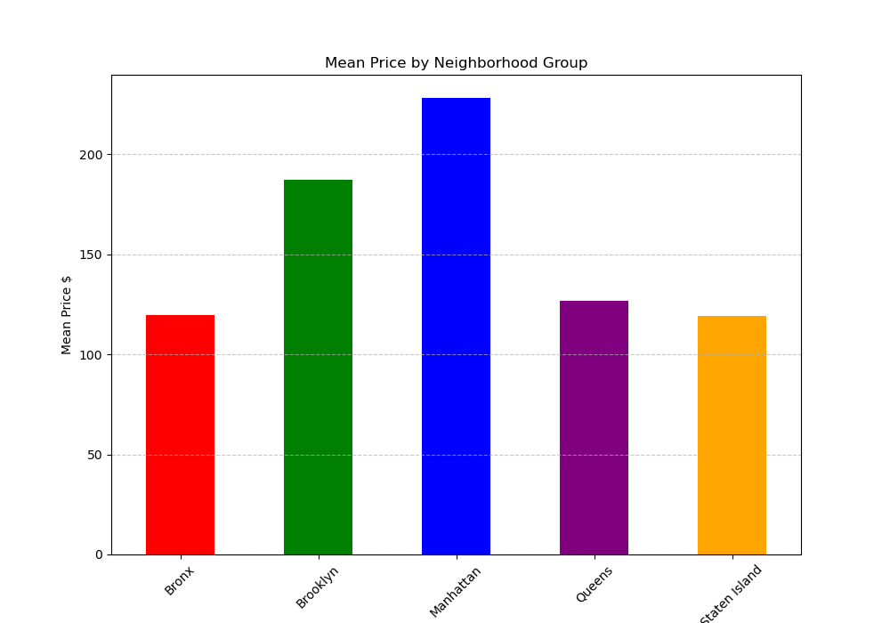
FIVE BOROUGHS PRICING
AirBnB listings are offered at a variety of mean price ranges throughout the five boroughs. The prices can range from $30 per night to over $9000 per month.
Notes:
THE MEAN COSTS CAN RANGE FROM $30 FOR A SINGLE NIGHT
TO MONTHLY & YEARLY PRICES THAT CAN COST OVER $9000 PER MONTH FOR AN AIRBNB RENTAL

Slide 8
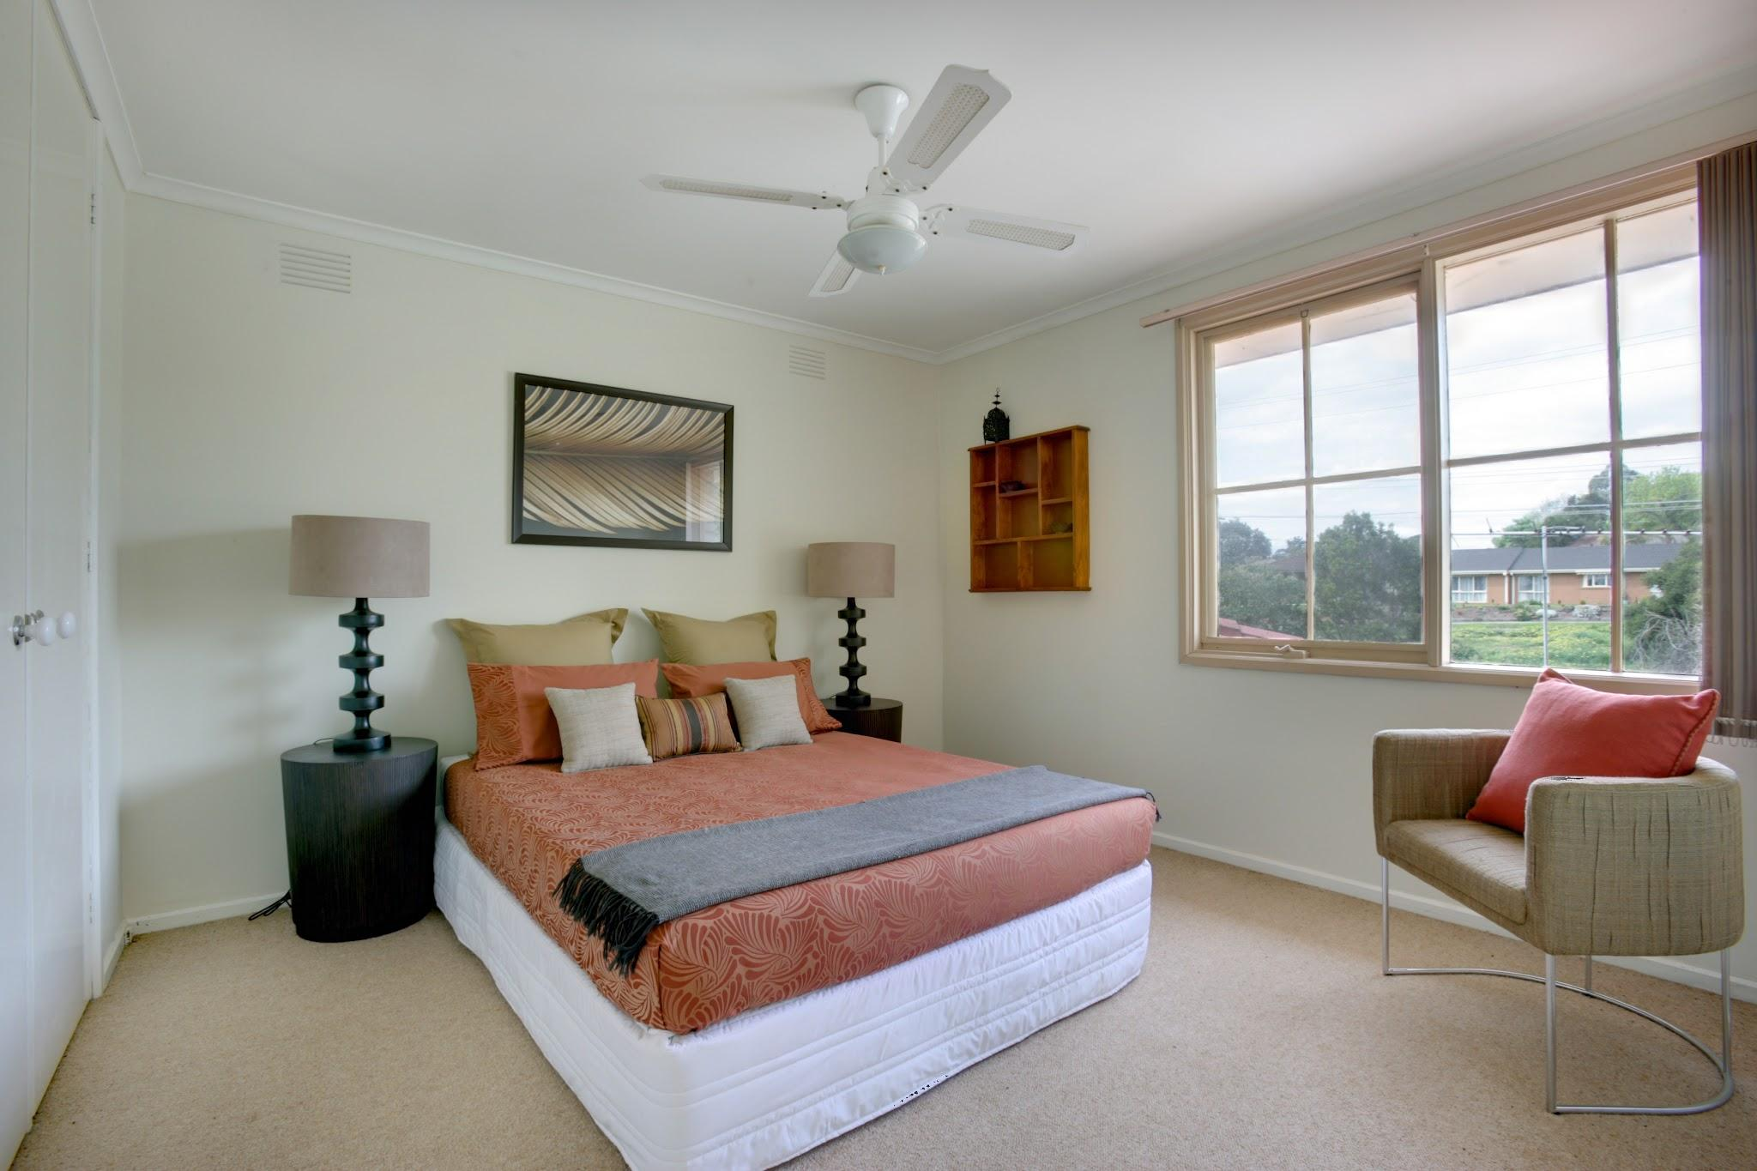
Number of bedrooms by Borough

Slide 9
Why is this important?
Why would someone need to know the average number of bedrooms by borough?
The average amount of time tourist spends in New York is at least 3 days.
You don’t want to overspend on a place that has more than needed, but you also want to make sure there are enough beds.
Tourists would probably like to get a rough estimate, on what boroughs have listings that best fit their needs in regards to bedrooms.

Slide 10
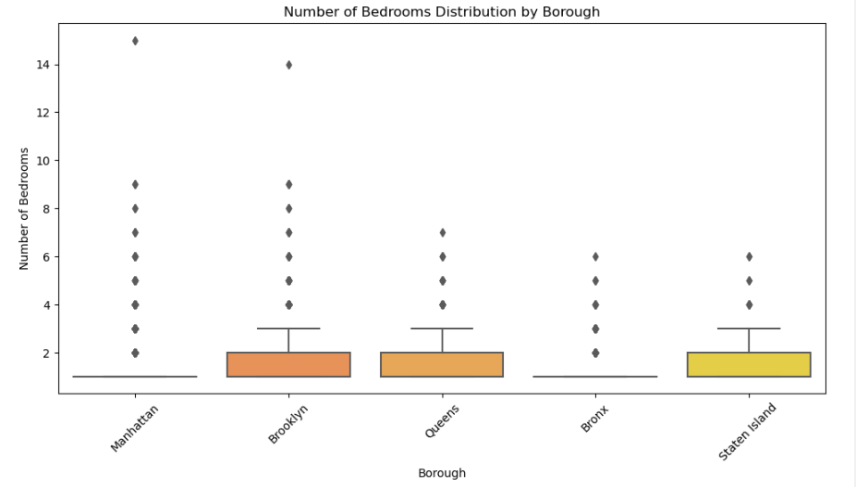
Highest number of bedrooms
Number of bedrooms ranges from 1 to 15
The dataset provided one listing in Manhattan with 15 bedrooms, 21 beds and 6 bathrooms for $1815/ night
Bedrooms - 15
Beds - 21
Borough - Manhattan
Price - $1815 per night
Notes:
The number of bedrooms in the data ranges between 1, being the most recurring number, and the highest being 15, only occurring once. This listing is in Manhattan with 21 total beds, and $1,815 per night.

Slide 11
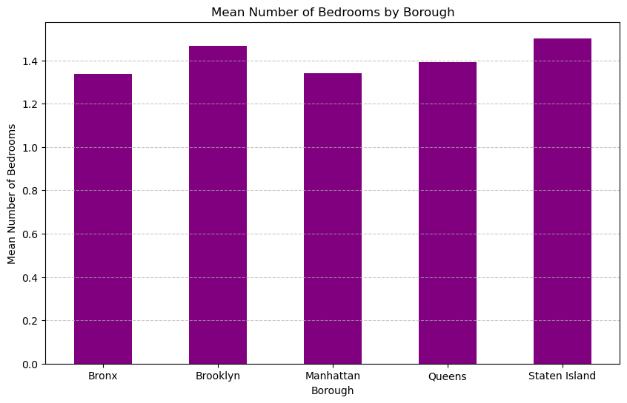
Average Number of Bedrooms
Averages range from 1.3, to 1.5 bedrooms
Average number of bedrooms across all boroughs is 1.4 bedrooms
Notes:
The difference between the average number of bedrooms does not vary all that much, ranging from about 1.3, to 1.5 bedrooms.
The mean number of bedrooms across all boroughs being 1.4

Slide 12
Results from this data
Manhattan
Lowest average number of bedrooms
Largest number of listings
Staten Island
Highest average number of bedrooms
Lowest number of listings
ANOVA testing
F-statistic: 26.384755782735148
P-value: 7.424893133755032e-22
There are significant differences in number of bedrooms among boroughs.
Notes:
Manhattan seemed to have the lowest average, but it is also the borough that occurs the most (7810 listings) out of the dataset that was analyzed, and it is the most popular place to stay for tourists. Staten Island occurs the least (285 listings), and yet had the highest average. From this, I would like to point out a limitation in the dataset. The disparity of listings is something worth noting, and thus, a confident conclusion of the average number of bedrooms by borough can not be drawn. However, if it does tell us anything, the ANOVA test results suggest there is a significant difference between the average number of bedrooms per borough.

Slide 13
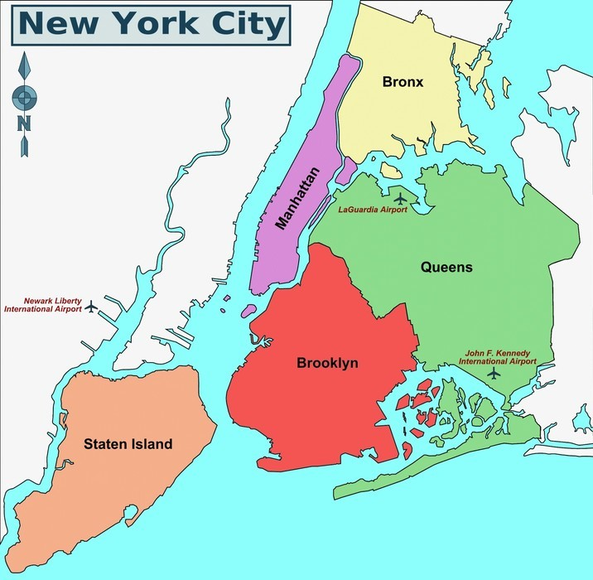
Insight into the Price disparity in Boroughs

Slide 14
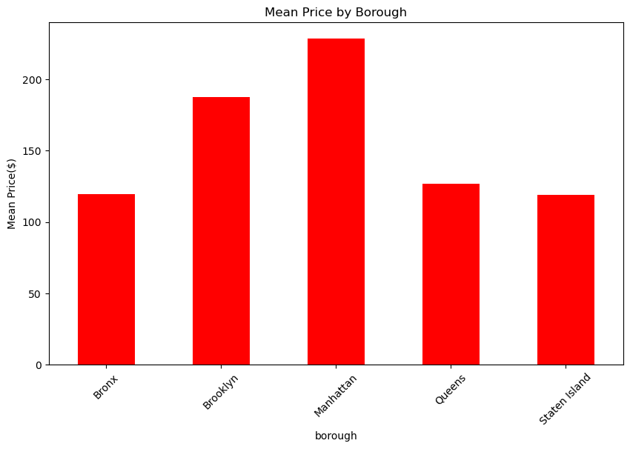
MANHATTAN
Manhattan is the commercial, financial, cultural, and entertainment hub of New York City.

Slide 15
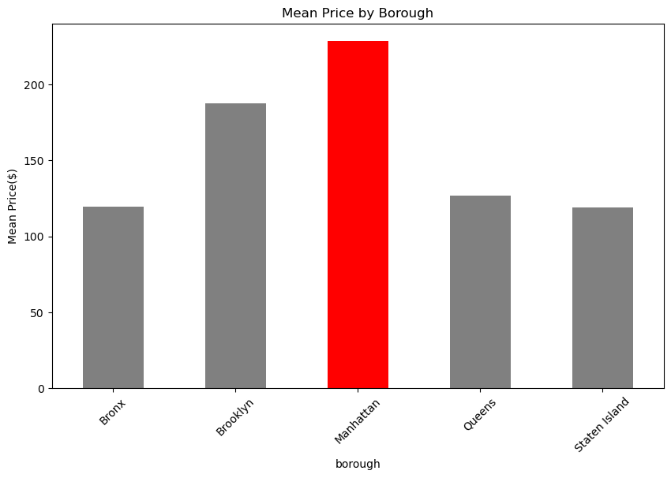
Location-Based Pricing Trends
≈
According to Travel Channel, the borough with the most tourist attractions is Manhattan
Central park
over 42 million visitors annually
Times Square
≈ 50 million visitors each year
Empire State Building
≈ 4 million visitors annually
MoMA
over 3 million visitors annually
The Met
≈ 7 million visitors annually
Broadway
≈ 14 million attendees annually

Slide 16
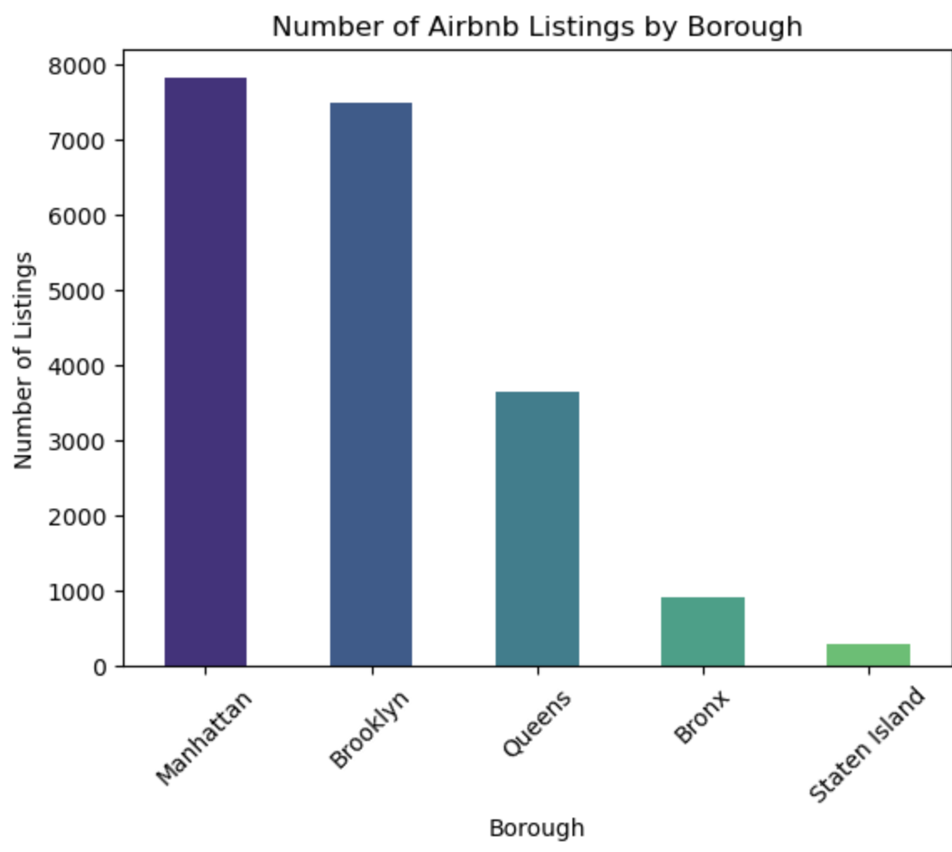
Competition
Due to the influx of popular tourist attractions Manhattan also has the most amount of listings
Manhattan: 7810 listings
Brooklyn: 7488
Queens: 3648
Bronx: 918
Staten Island: 285

Slide 17
Utilizing statistical analysis techniques, we CREATED A violin chart visualization to elucidate our findings.
Statistical Analysis

Slide 18

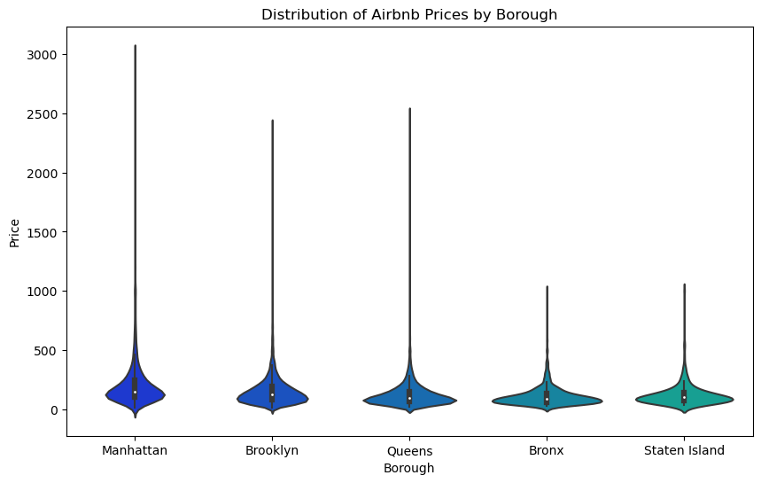
Violin Charts
The white dot represents the median
The thick gray bar in the center represents the interquartile range
The thin gray line represents the rest of the distribution, except for points that are determined to be “outliers” using a method that is a function of the interquartile range.
The widest section of the violin plot represents the highest density of data points.

Slide 19
Violin Charts
The white dot represents the median
The thick gray bar in the center represents the interquartile range
The thin gray line represents the rest of the distribution, except for points that are determined to be “outliers” using a method that is a function of the interquartile range.
The widest section of the violin plot represents the highest density of data points.

Slide 20
Violin Charts
The white dot represents the median
The thick gray bar in the center represents the interquartile range
The thin gray line represents the rest of the distribution, except for points that are determined to be “outliers” using a method that is a function of the interquartile range.
The widest section of the violin plot represents the highest density of data points.

Slide 21
Violin Charts
The white dot represents the median
The thick gray bar in the center represents the interquartile range
The thin gray line represents the rest of the distribution, except for points that are determined to be “outliers” using a method that is a function of the interquartile range.
The widest section of the violin plot represents the highest density of data points.

Slide 22
Price disparity among the 5 Boroughs
Manhattan varies the most
Staten island and The Bronx have the most consistent pricing

Slide 23
Statistical Analysis
After conducting an ANOVA test we concluded that:
There are significant differences in prices among boroughs.
Conclusions
Stats
Manhattan is the most expensive.
Staten Island is the least expensive.
F-statistic:
26.384755782735148
P-value:
7.424893133755032e-22

Slide 24
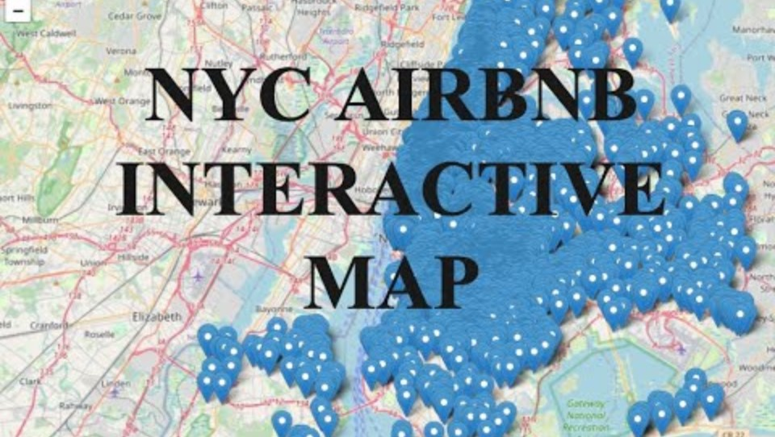
INTERACTIVE MAP

Slide 25


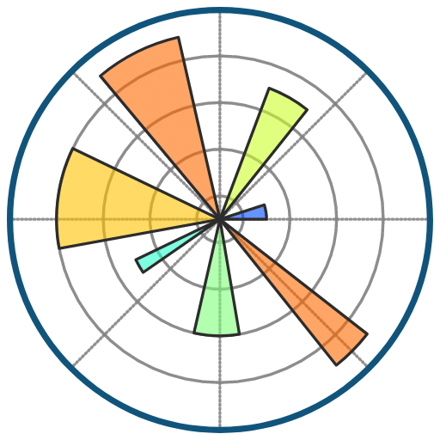


THANKS!
Does anyone have any questions?
Presented by:
Taylor Hipkins, Joey Ditizii and Jeff Morgan
Images and code were powered by:

Slide 26
Resources
GBSN Research. (n.d.). New York City Rent Prices by Borough and Neighborhood. Retrieved from https://gbsnresearch.com/insights/data-processing/new-york-city-rent-prices-by-borough-and-neighborhood/
Travel Channel. (n.d.). NYC: Best of the Boroughs. Retrieved from https://www.travelchannel.com/destinations/us/ny/new-york-city/articles/nyc-best-of-the-boroughs
Concorde New York, How Long to Stay When Visiting New York City, https://www.concordehotelnewyork.com/blog/how-long-to-stay-when-visiting-new-york-city
Sound Effect Licensing:
The “dun-dun” sound effect is permitted for non-commercial use under
license “Attribution-NonCommercial 4.0 International (CC BY-NC 4.0) http://www.orangefreesounds.com/
Video Licensing:
Video was Ai generated by https://video.pictory.ai/ ; video and narration are free for educational and non-commercial use

Slide 27


